Slide 1
Preliminary Analysis of Veteran Disability
Amanda Fredrickson
DAP2 Final Project

Slide 2
Motivation

Slide 3
Research Question

Slide 4
Where I Got the Data

Slide 5
Methods Used

Slide 6
Discussion of Figures Part 1/3

Slide 7
Regression Model

Slide 8
Demo Shiny App

Slide 9
Summary of Findings

Slide 10
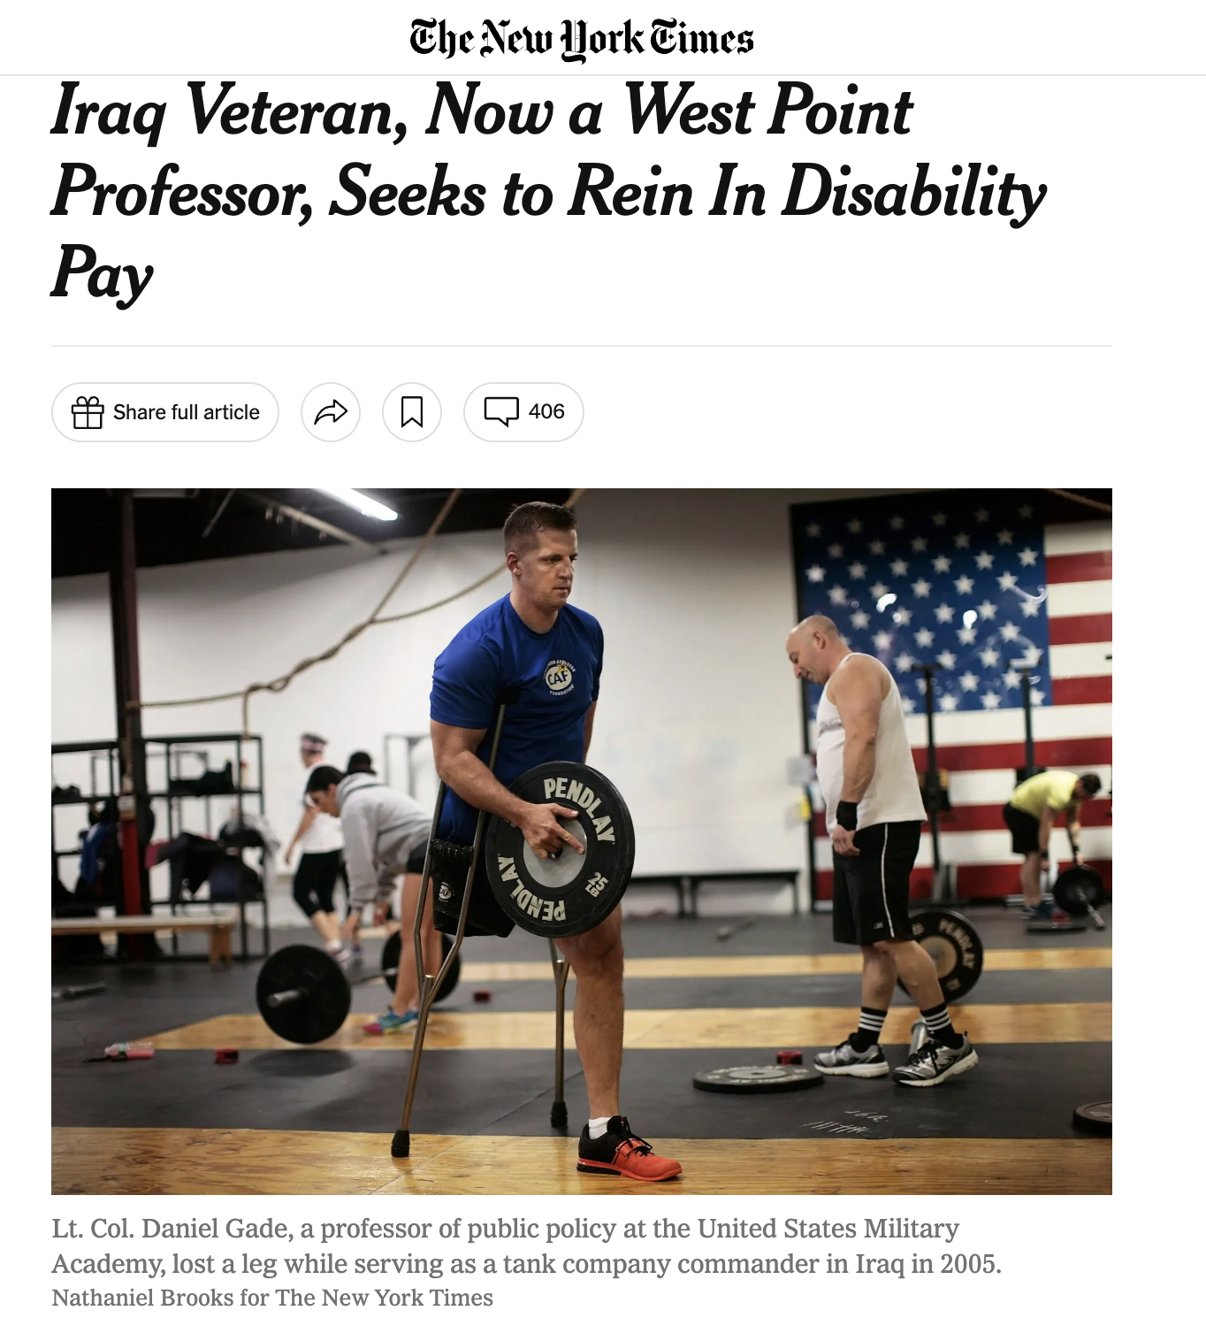
Conclusion and Directions for Future Work

Slide 11
Questions?
Thank you!

